Slide 1

Examining Nutritional Quality of Meals on a Swiss Digital Nutrition Cohort
Sophie Holtz
May 2022

Slide 2
Introduction
Context : micronutrient adequacy, dietary quality, nutrient balance
Study Framework : Nutrient Balance Concept (NBC)

Slide 3
Research Objectives
Validate NBC framwork with real-world data
Assess nutrient quality across different meal types
Explore temporal and spatial variations in nutrient intake

Slide 4
Methods – Data Collection
Data Source : Swiss digital nutrition cohort, OpenFoodFacts
Initial dataset : 399’824 records
Data processing : Filtering, imcomplete records, outliers removal, portion size standardization
Final dataset : 149’483 records

Slide 5

Methods – Nutrient Index Computation
All indices were normalized to 2000 kcal
$$QI= \frac{E_{d}}{E_{p}}×\frac{1}{N_{q}}\sum_{j=1}^{N_{q}}{\frac{a_{qj}}{r_{qj}}}$$
$$DI= \frac{E_{d}}{E_{p}}×\frac{1}{N_{d}}\sum_{j=1}^{N_{d}}{\frac{a_{dj}}{r_{dj}}}$$
$$NB(\%)= \frac{1}{N_{q}}\sum_{j=1}^{N_{q}}{min⁡\left(\frac{a_{qj}}{r_{qj}}, 1\right)×100}$$

Slide 6
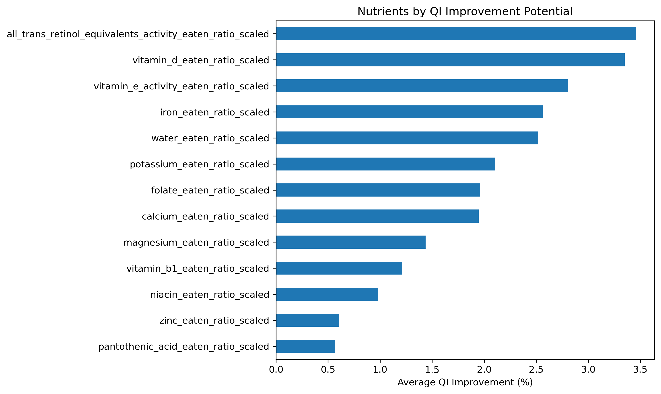
Results – Micronutrient Improvement Potential
Top deficiencies :
Vitamin A
Vitamin D
Vitamin E
Targetting these can improve QI

Slide 7
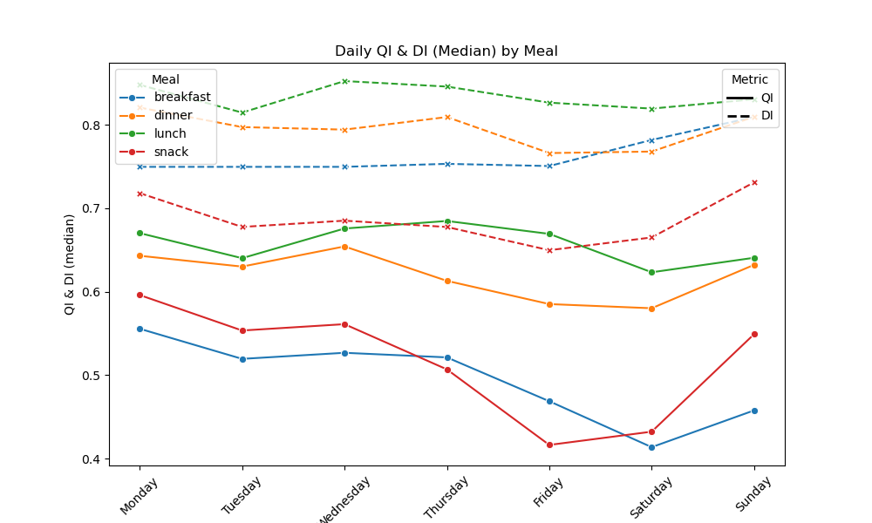
Results – Composite Indices by Meal Type
Lunches maintains high QI and DI
Snacks consistently underperform
Weekends show nutrional decline (esp. at breakfast)

Slide 8
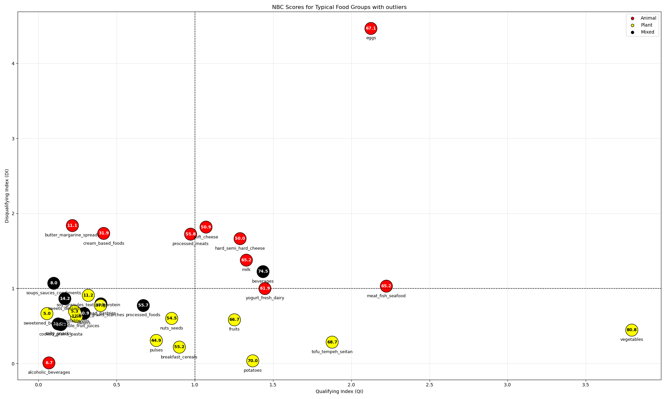
Results – Food Group Analysis

Slide 9
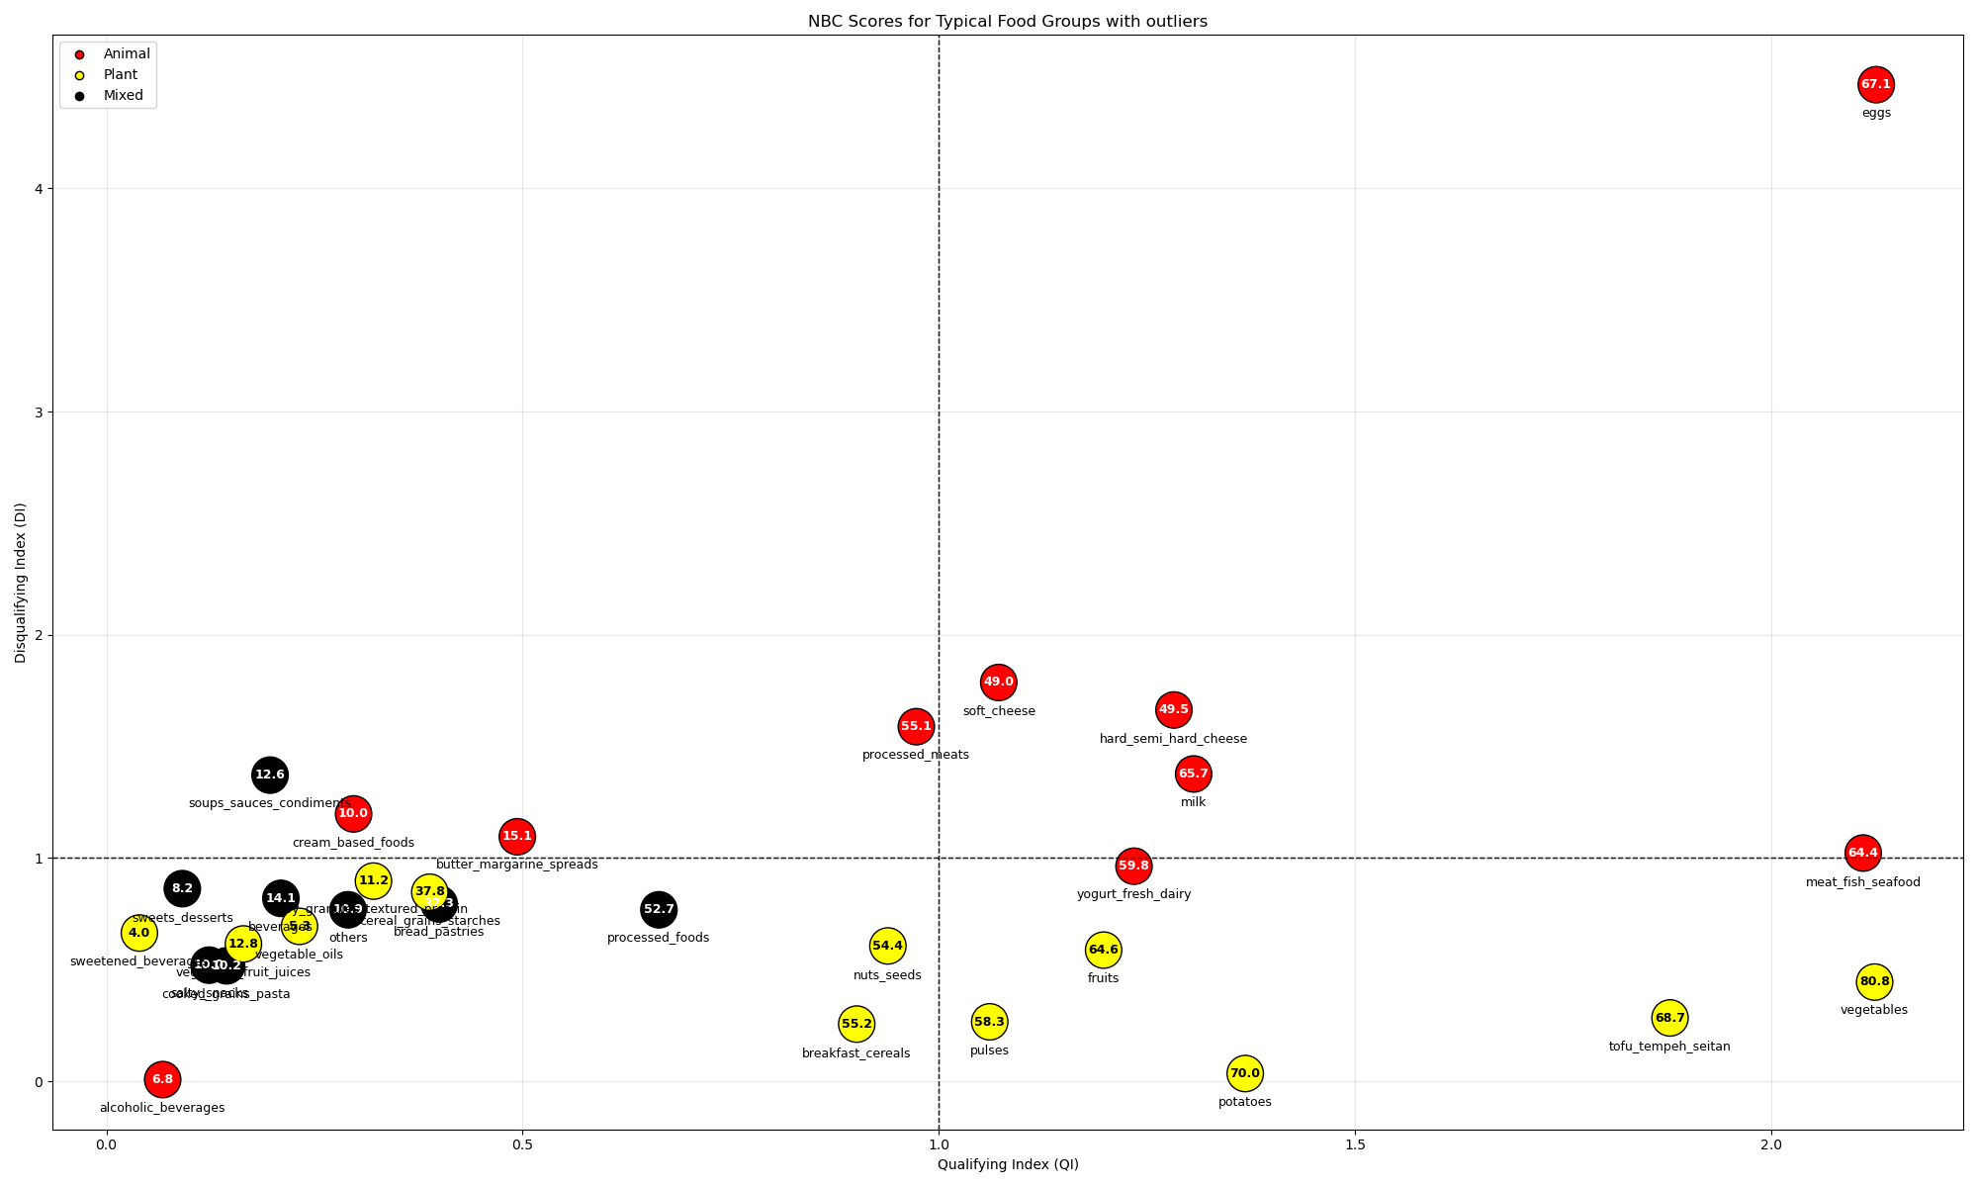
Results – Food Group Analysis

Slide 10
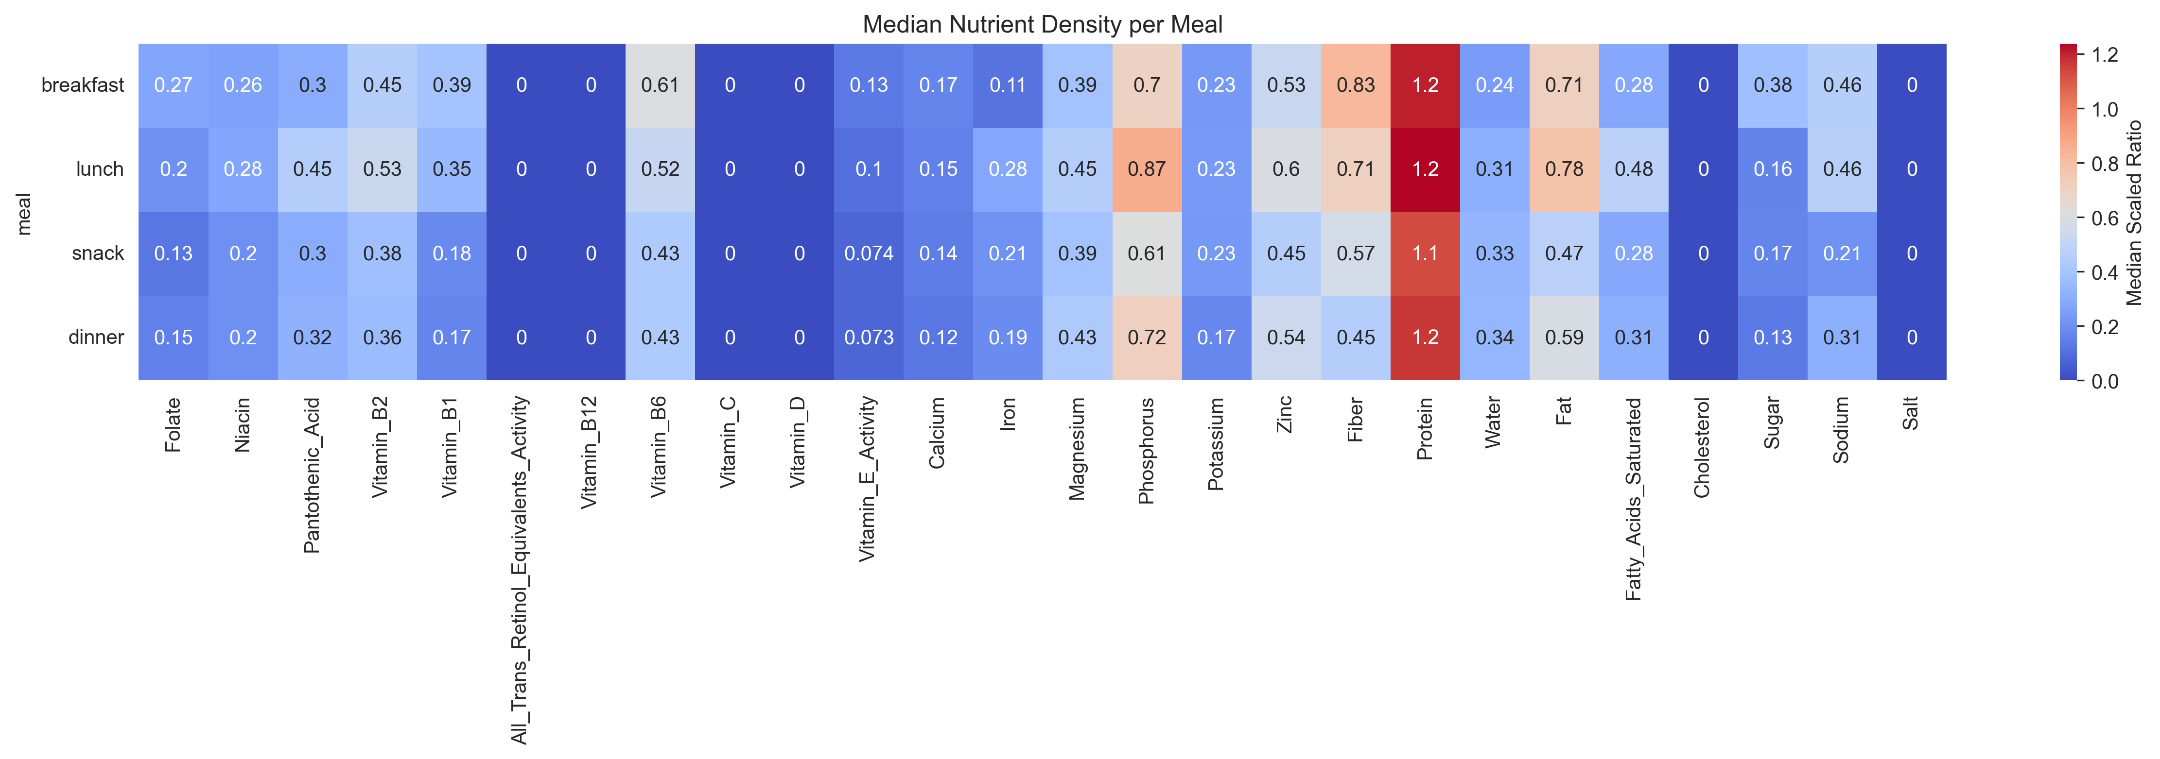
Results – Nutrient Density

Slide 11
Discussion
Main Findings :
Nutrient density
Meal quality
Temporal variation
Micronutrient deficiencies
Meal Hierarchy
Data Validation
Real-World Insights

Slide 12
Implication and Limitation
Public Health Impact
Behavioral Insights
Data Quality
Population Diversity
Methodological Limits

Slide 13
Future Directions
Personalization
Temporal Optimization
Technological Integration
Predictive Modeling
Public Health Strategy

Slide 14
Conclusion
NBC framework effective for real-world dietary profiling
Strategid reformulation and personalization are key

Slide 15
Thank you

